Slide 1

Bakery Prediction – Room 7
08.01.2026
Lasse Frohnert, Farida Rahimova, Faramiz Bahaddinov, Vikram Vupparapalli

Slide 2
Dataset Characteristics – New variables
Temporal features:
Day, month, weekend, and seasonal information
Holiday & Event Features:
Kieler Woche, holidays and vacation periods
Engineered Weather Features:
Categorical and derived weather features
Interaction Features:
weekend_season_interaction
bewoelkung_weekend_interaction
…

Slide 3
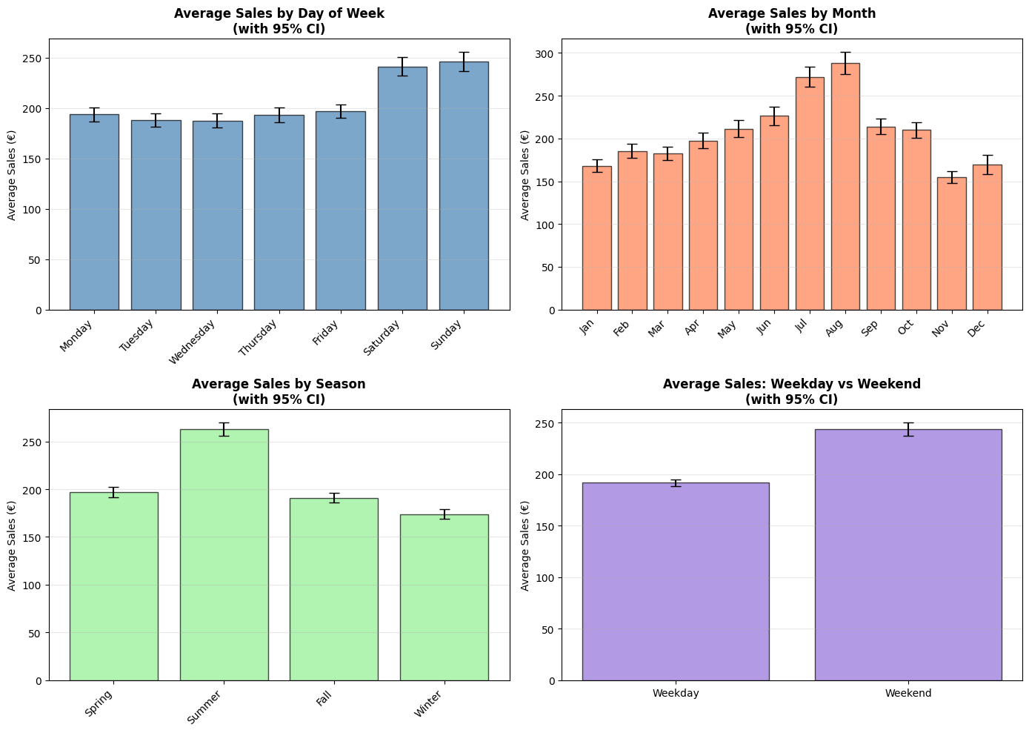
Dataset Characteristics – Bar Charts

Slide 4
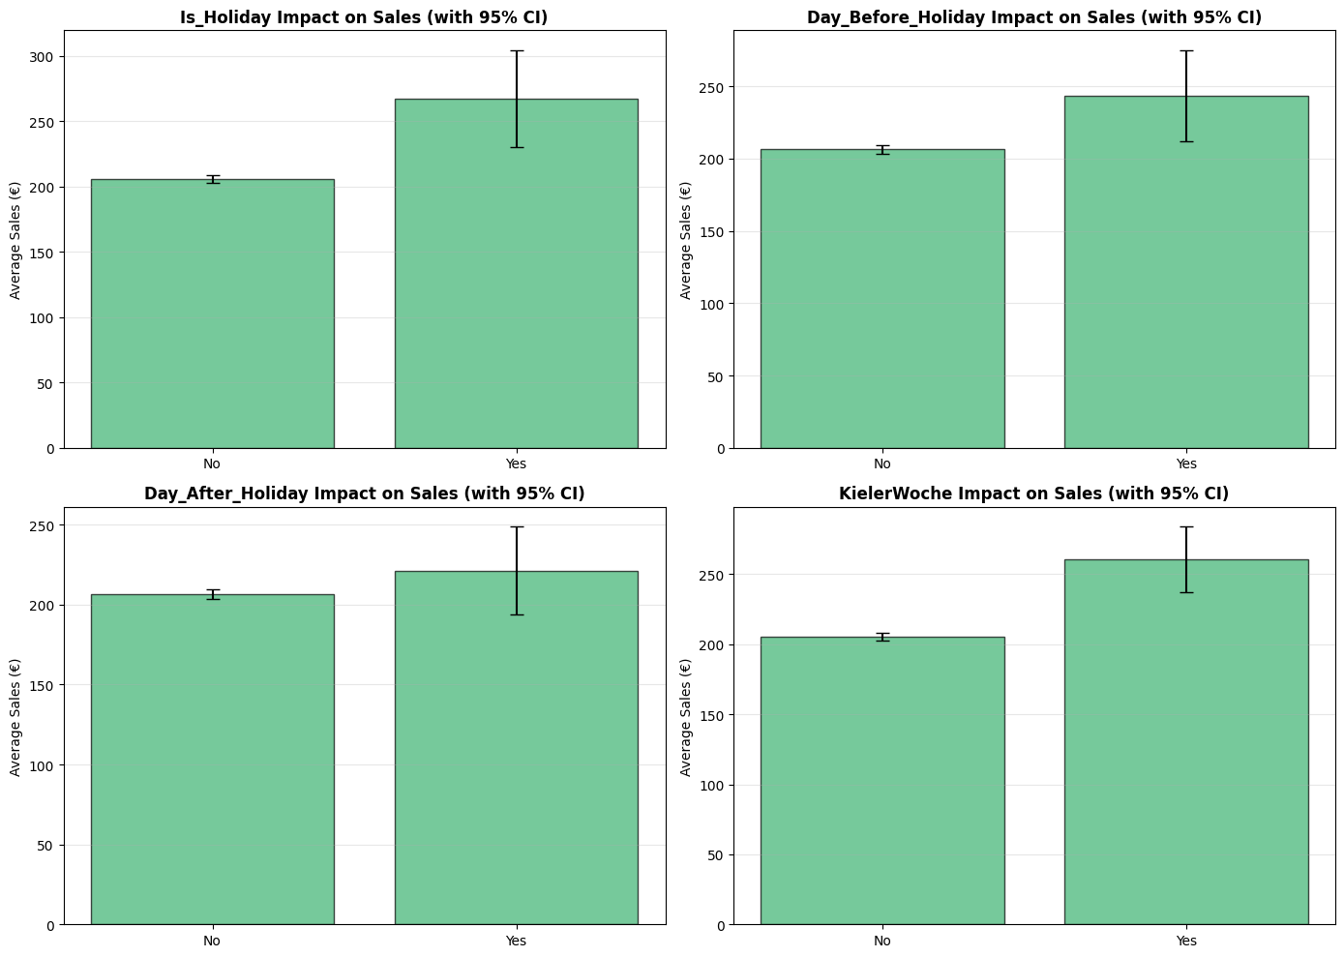
Dataset Characteristics – Bar Charts

Slide 5
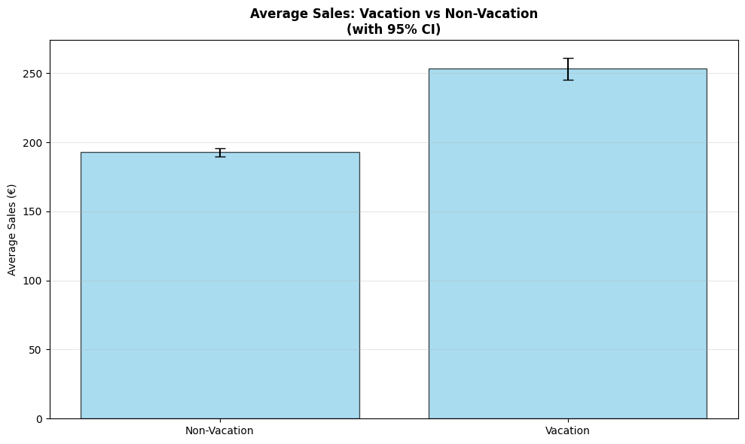
Dataset Characteristics – Bar Charts

Slide 6
Baseline Model
Baseline Model: Multiple Linear Regression
2 Numeric Features: Temperatur, Bewölkung
10 Categorical Features: Warengruppe, day_of_the_week, month, is_weekend, Is_Holiday, Day_Before_Holiday, KielerWoche, wettercode_category, season, temperature_category
Through One-Hot encoding ended up with 59 Features in total
Performance:
MAPE = 32.76%
R² = 0.7139

Slide 7
Improved Model – Implemented Model
Time-Enhanced Linear Regression with Bias Correction
Algorithm: Ordinary Least Squares Linear Regression
Training approach: Single model trained on all product categories with one-hot encoding
Bias correction: Post-processing step that adds category-specific mean residuals to predictions
Feature count: 64 features after encoding (2 numeric + 62 categorical dummies)

Slide 8
Improved Model – Feature eNgineering steps
1. Time Features
Cyclical encoding: week_sin/cos, quarter
Calendar: month, day_of_week, weekend, holiday flags
2. Product Group Signal
Group mean sales per Warengruppe (training data only)
3. Weather & Context
Numeric: Temperatur, Bewoelkung
Categories: weather conditions, temperature ranges, season
4. Encoding
One-hot encoding: 10 categorical → 64 features total
Outlier clipping + time-aware missing value fill
5. Bias Correction
Add per-category mean residual to predictions

Slide 9
Improved Model – Evaluation
Incremental testing: Each feature set tested against baseline
Regularization: Lasso (α=1) kept 33/59 features → confirmed time/group features valuable
Bias detection: Per-category residuals revealed systematic offsets → correction improved all groups uniformly

Slide 10
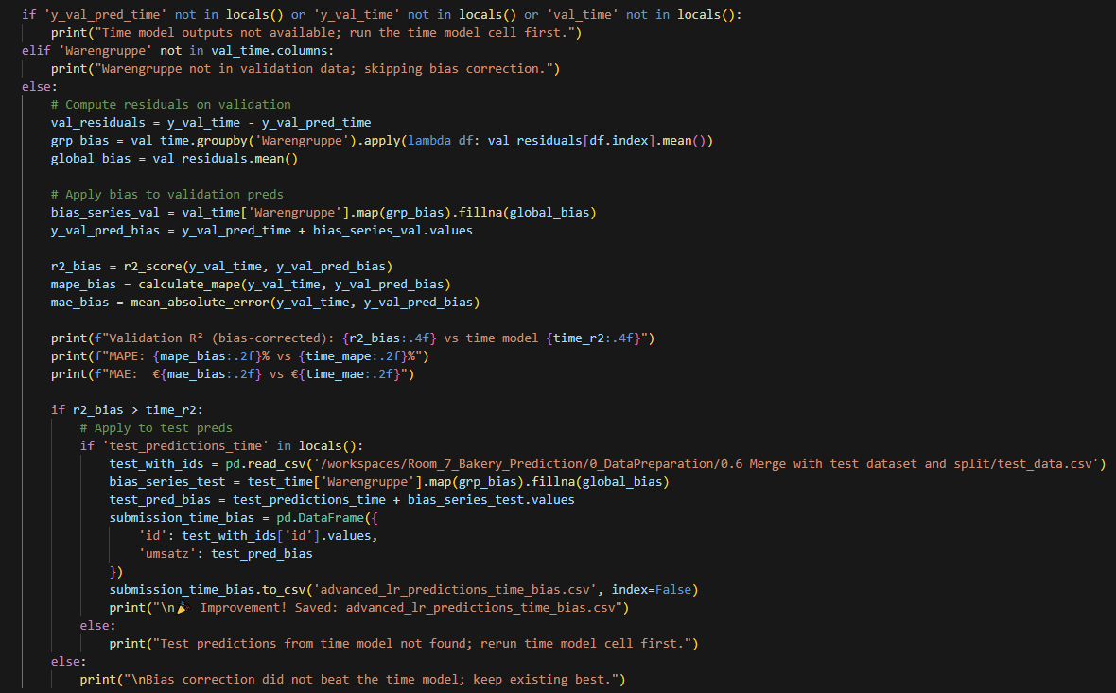
Improved Model - Code

Slide 11
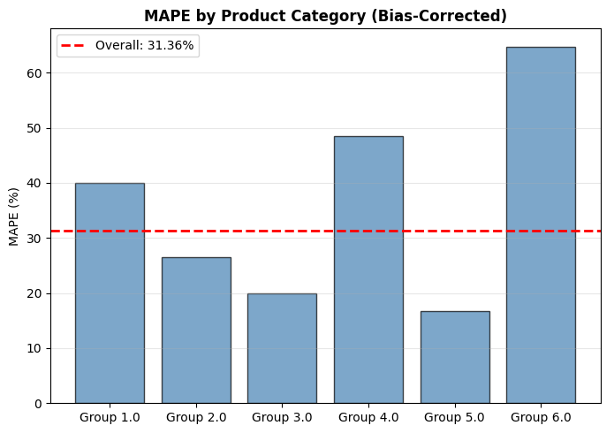
results
MAPE for each product group
Group 1.0 = 40.03%
Group 2.0 = 26.44%
Group 3.0 = 19.87%
Group 4.0 = 48.49%
Group 5.0 = 16.71%
Group 6.0 = 64.77%

Slide 12
Challenges and Errors
Missing values for Wettercode was a challenge because 23% of the data was missing.
Tried getting the missing data from open-meteo, but it was missing a lot of the WMO-code and didn‘t fit to our data
Employed forward filling with a Monthly-Based Mode Fallback and Global-Based Mode Fallback

Slide 13
Q & A
Thanks for listening!
Any questions?

